Slide 1




Natural language processing to capture person-first or identity-first language
Dr. J. Kasmire
Cathie Marsh Institute, University of Manchester
UK Data Service

Slide 2
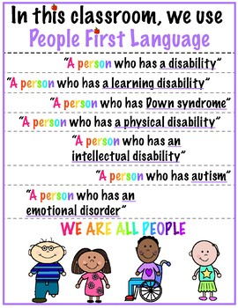
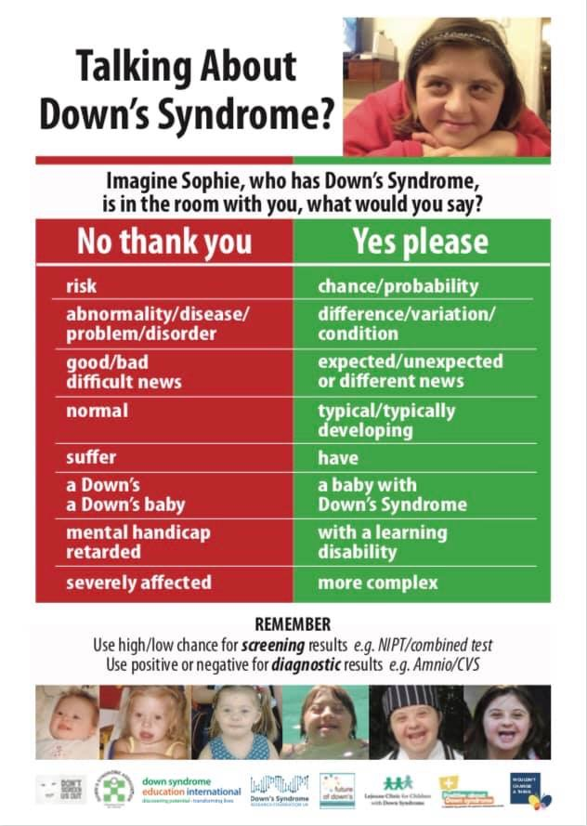
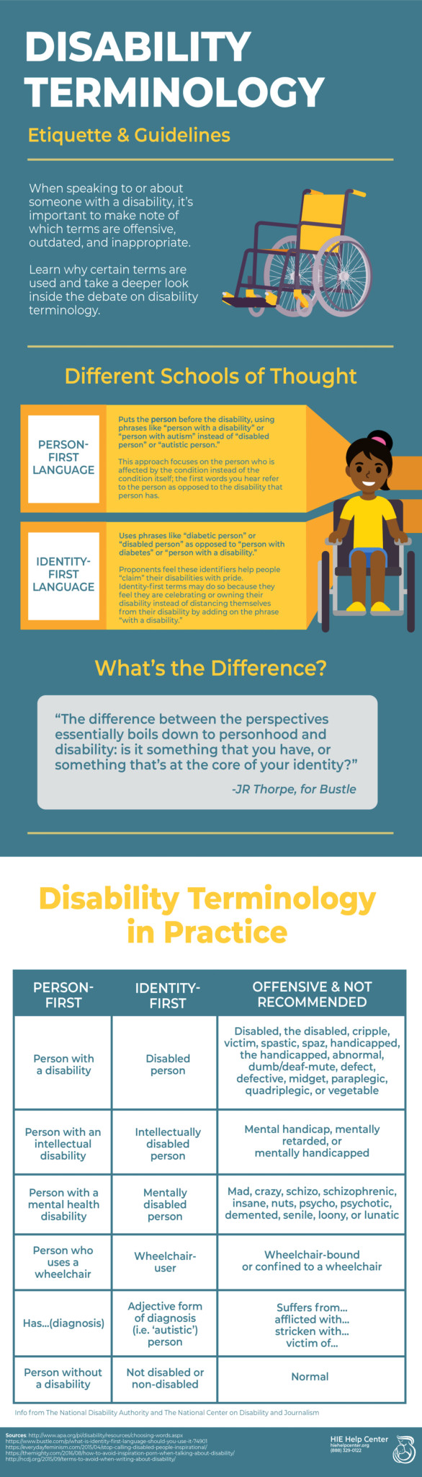
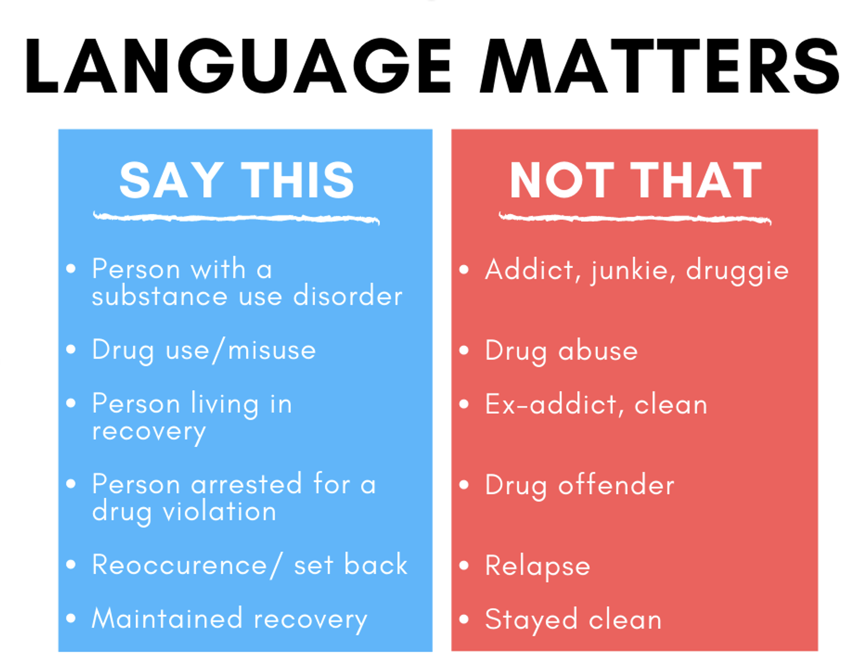
Notes:
I won’t go through all of these, but I just want to illustrate that for lots of people, language matters a lot and there are clear preferences about terminology.

Slide 3

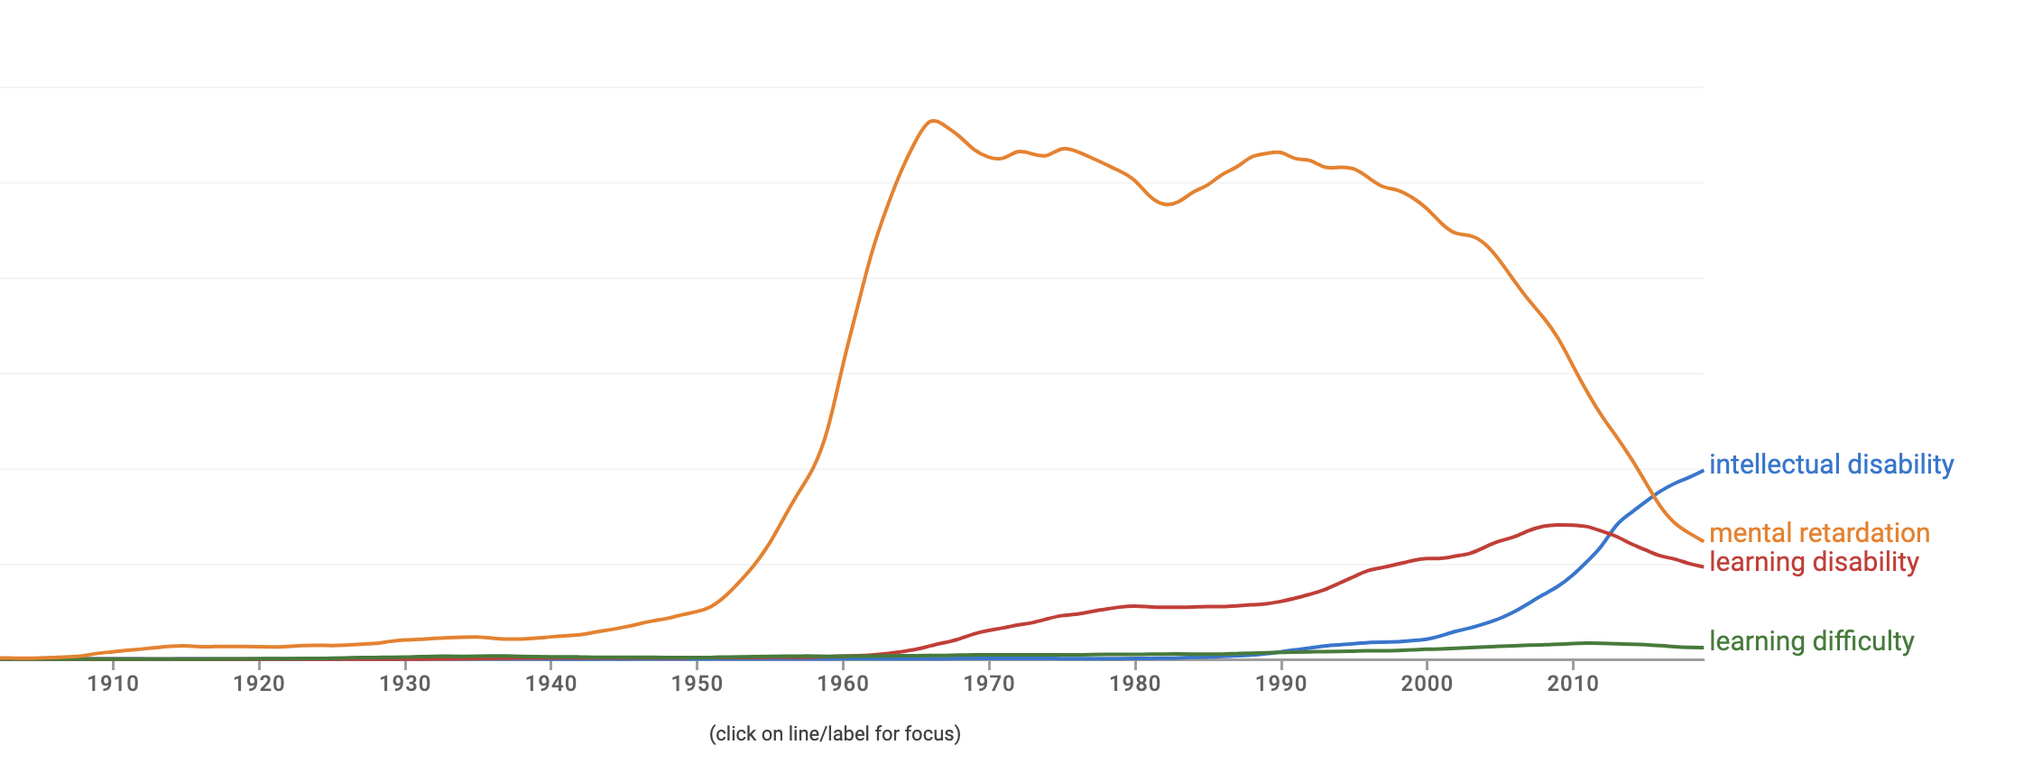
Notes:
As an example, here is Google’s Ngram viewer showing the popularity in several terms that are often understood as meaning the same or similar over time. Clearly, intellectual disability is has recently taken the lead to replace the term that was a clear leader for over 50 years.

Slide 4
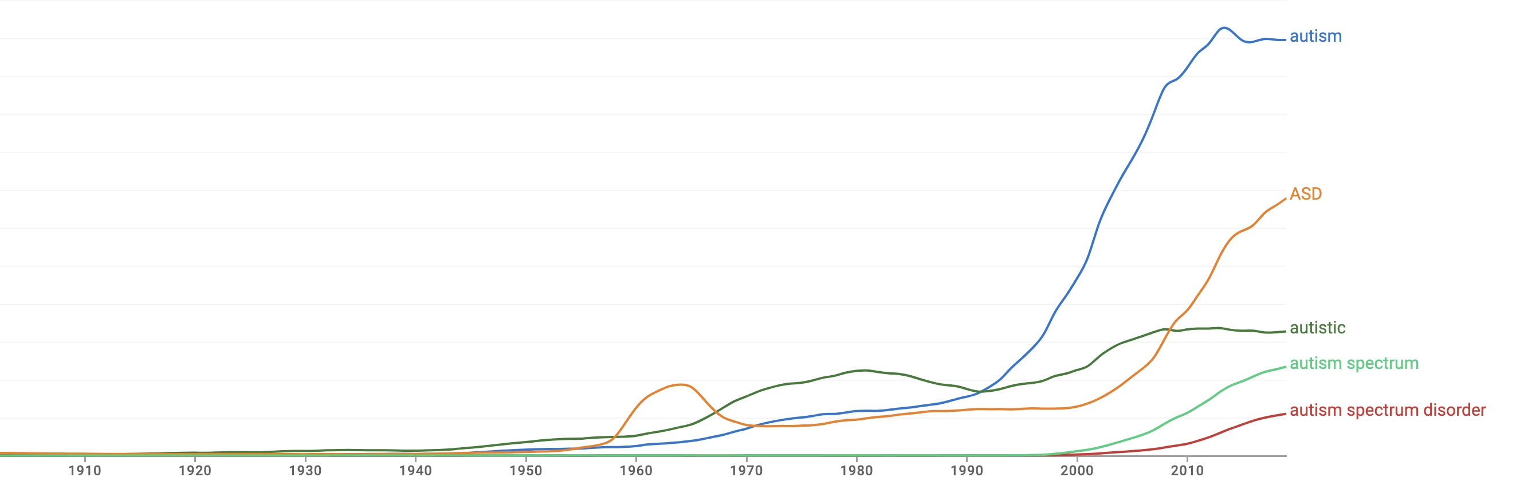
Notes:
Likewise, we see that autism is increasingly used, as is ASD while autistic has flatlined quite a bit in the recent past.

Slide 5
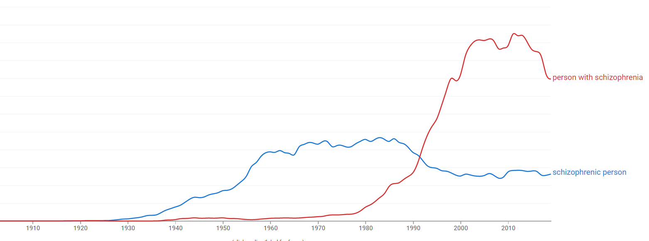
Notes:
Here is another example of terms changing drastically in use over time.

Slide 6
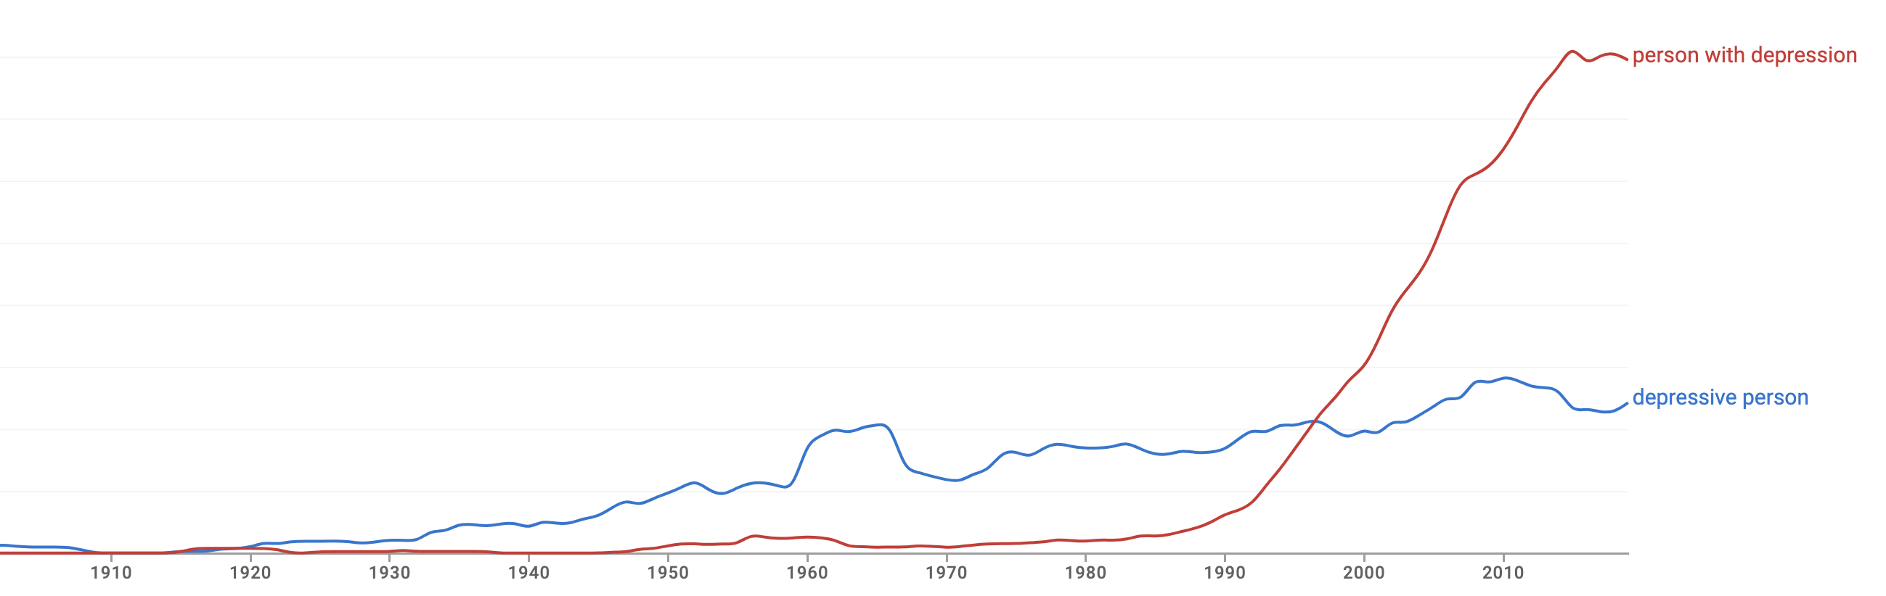
Notes:
And a final example showing the rapid growth in use of ‘person with depression’

Slide 7
Which term would you use?
A – Infertile couple
B – Couple with fertility problems
C - Other
D – Both/It depends

Slide 8
How about these terms?
A - Clever person
B – Person with cleverness
C - Other
D – Both/It depends

Slide 9
Another one for you!
A – Brown eyed girl
B – Girl with brown eyes
C - Other
D – Both/It depends

Slide 10
And now?
A - Autistic boy
B – Boy with autism
C - Other
D – Both/It depends

Slide 11
Polite terms for impolite ideas
People use euphemisms when what they want to describe makes them uncomfortable/is seen as negative, icky or taboo.
Notes:
Now, euphimisms. Think of the difference between the words we use for body parts or bodily waste when we talk to children or in professional contexts as opposed to informal contexts with adults.
So, impolite ideas includes conditions or traits or experiences that are undesirable or unfortunate. So, schizophrenia, depression, infertility etc. are treated differently than clever, which is a positive thing, or brown-eyed which is pretty neutral. Thus, clever or pretty or healthy goes in the normal English language position for adjectives which schizophrenia or depression or infertility gets put in a euphemistic “person with noun” structure.

Slide 12
Euphemism treadmill
The ‘euphemism treadmill’ is the process by which the euphemism itself comes to be seen as derogatory, pejorative, or taboo at which time it is replaced by a new euphemism and the cycle continues.
Notes:
But over time, we get a treadmill effect with euphemisms.
The polite term comes to be seen as impolite if the thing it describes remains uncomfortable for the speaker or for a majority of speakers. So a new euphemism is created and used until it too becomes problematic and is itself replaced.

Slide 13
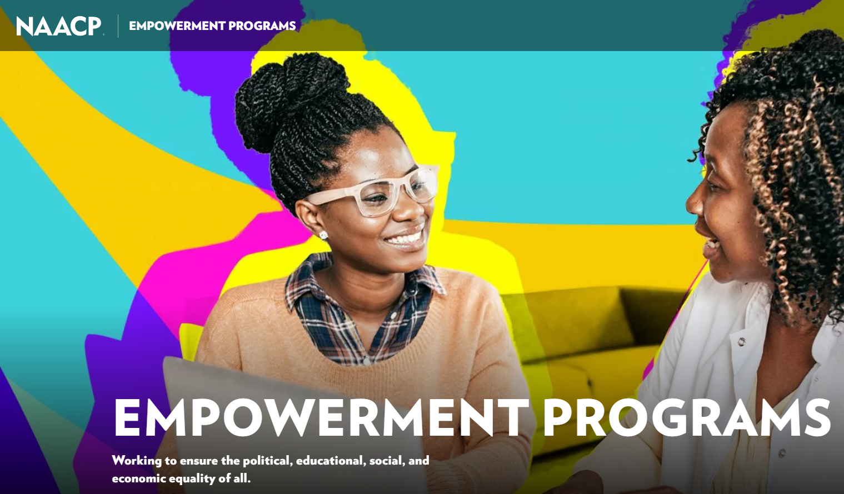
Euphemism treadmill example
Notes:
The NAACP is a long lasting and well-respected institution in the USA that works for racial equity, among other things. The acronym stands for the National Association for the Advancement of Coloured People, which we know was at one point in time the “right term” but is now one of the things “we don’t say anymore” and instead use the very semantically similar “people of colour”. Despite the change in euphemisms, the NAACP has decided to keep the original name and the respect it has built up while using that name rather than change its name every time the euphemism shifts. This is probably because they don’t expect the treadmill to slow down or stop any time soon as race still makes many Americans uncomfortable.

Slide 14

Reclaiming euphemisms?
tzigane
More negative connotations than “roma” but used by some members to refer to themselves without offence
queer
Originally meaning “strange” or “peculiar”, then used as a pejorative, later reclaimed as a deliberatively provocative term
Notes:
Similarly, some people deliberately take on a negative or pejorative term or use it for themselves. They do this as a community ingroup marker or as a deliberate attempt to make people face the discomfort they feel about the group.

Slide 15
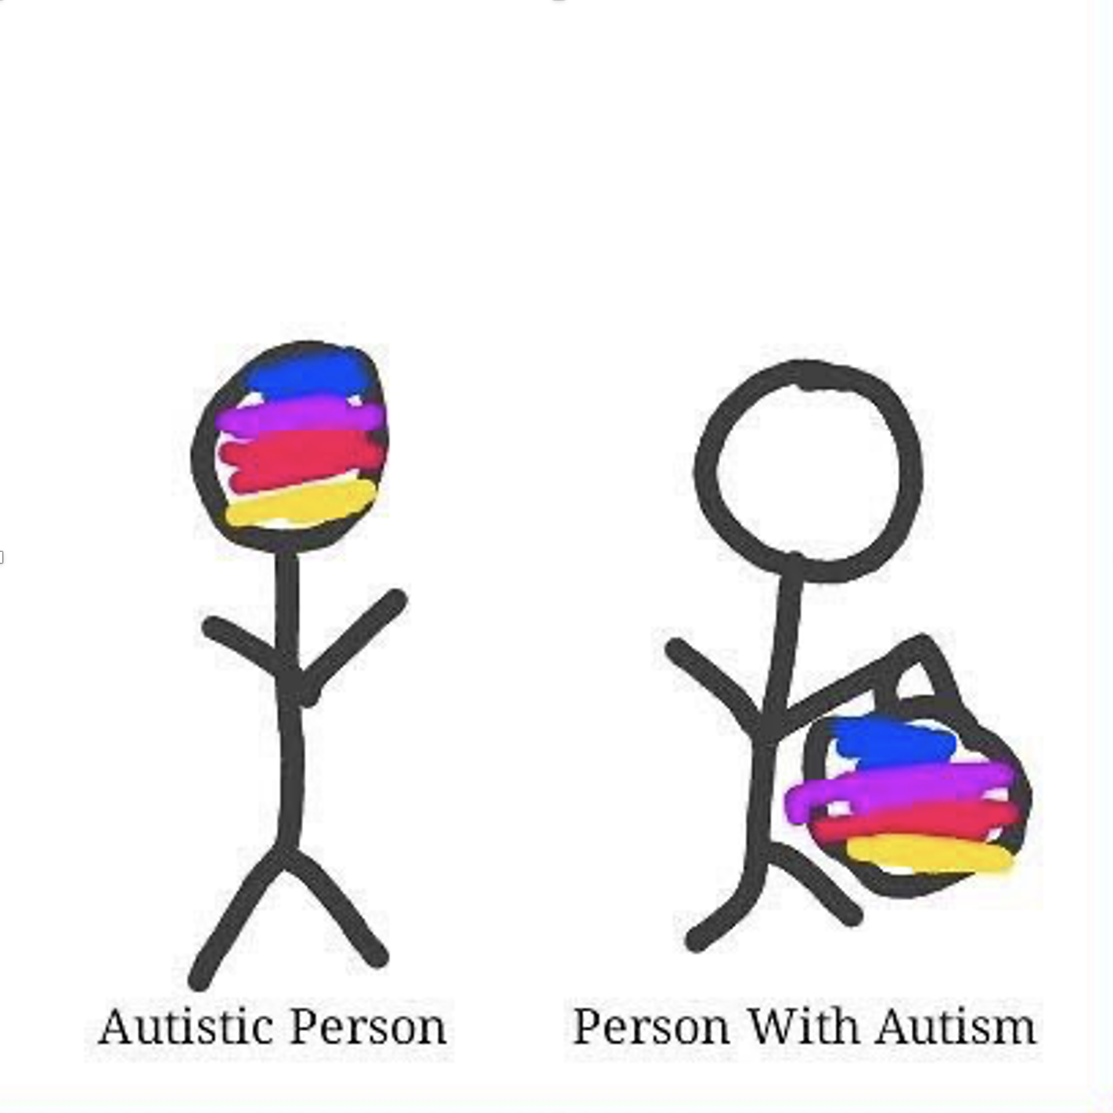
Person-first language
Person-first – “person with autism”, “child with hearing difficulties”, etc.
intends to highlight personhood before diagnosis
meant to avoid dehumanisation, marginalisation, or essentialisation
describes what a person “has” rather than what a person “is”
Notes:
So now we come to person-first language which uses the very well-meaning euphemistic structure to highlight personhood before diagnosis. It intends to avoid dehumanising the person by describing what they have rather than what they are.
Unfortunately, by using the same structure as other well-known euphemisms, person-first identity may unintentionally be emphasizing how the diagnosis is seen as unfortunate, undesirable or uncomfortable.

Slide 16
Identity-first language
Identity-first - “an autistic person”, “a Deaf child”, etc.
some people see these terms as part of their identity/community
doesn’t separate person from adjective or suggest people are “same” with …
social model of disability suggests people “are” disabled by society
Notes:
In contrast, identity-first language embraces the terms by putting them in the normal English-language position for adjectives, just as they would for positive or neutral adjectives like clever or healthy. Indeed, some of the people thus described do see these terms as positive, at least in the sense of being an integral part of their identity or a unifying feature of their community. This approach also doesn’t suggest that people are really all the same apart from incidental things that they just happen to be carrying around.
Further, identity-first language is associated with the social model of disability that suggests people are disabled, but by society rather than by their bodies or their behaviour. The social model of disability includes the idea that confronting disability as a result of society head on may cause discomfort but is the best way to make positive change. For this reason, I personally use identity-first language to describe myself.

Slide 17
Aim: examine person-first and identity-first language in genetics research
ESHG abstracts, 2001-2021
Natural language processing methods
Explore word frequency, change over time & potential influencing factors
Pilot study looking at data focused on *autism*
Notes:
Now, half way through my presentation, I get to my point. In our research we set out to examine person-first and identity-first language in 20 years of ESHG abstracts.
We used natural language processing methods to look at word frequency, change over time and potential influencing factors.
We did this pilot study with a focus on autism because this is a term for which the best language is contested. We could, of course, run the same exploration on other terms of interest.

Slide 18
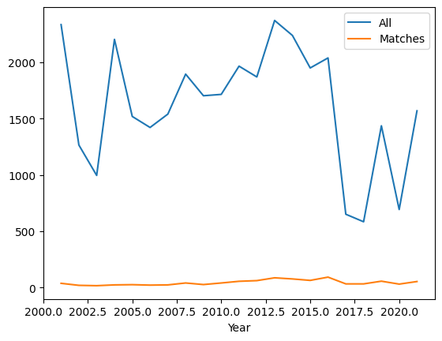
Data = ESHG abstracts from 2001 to 2021
36,835 abstracts in total
929 with the keywords “autism”, “autistic”, “ASD” or “asperger”
Notes:
First off, we had over 36 thousand abstracts in total, almost a thousand of which contained one or more of the keywords of interest.
We faced a lot of challenges in the processing, so were not able to capture absolutely every abstract but we got pretty close. The discrepancies arise from…

Slide 19
Preparation
31 .pdf files
Acquire original files
Convert .pdf to .csv
Turn .pdfs into .txts
NLP
Bag of words
Remove irrelevant pages (cover page, adverts, index, etc.)
Split text into rows in a .csv with columns for author, title, text, etc.
Pattern extraction
Identify patterns
Notes:
The process of converting original conference abstract .pdf files, which have a lot of irrelevancies like adverts or cover pages, into text and then into .csv. Each year was different, with titles, authors, affiliations, texts, session codes and such happening in slightly different ways that complicate the process of splitting the files into columns in a .csv.
Finally, the actual natural language processes, of which I did two approaches –bag of words and pattern extraction.

Slide 20
Have you ever used NLP?
A – Bag of words
B – Pattern extraction
C - Both
D – Neither
E – Other

Slide 21
NLP “bag of words” for word frequency
Prep
Tokenise words
Lowercase
Remove punctuation
Remove whitespaces
Remove stop words
Consolidate
* Correct spelling
* Substitute synonyms
Stem words
Analyse
Count most frequent words
Track frequency of specific words over time
* Optional steps that we did not use
Notes:
The bag of words approach has three steps -

Slide 22
Stemming collapses words to a basic form
Simplistic method that reduces nouns and verbs to the same form regardless of plurality, tense, person, etc .
Examples:
Dog, dogs, and dogged would all reduce to “dog”
Went, going, goes and go would all reduce to “go”
Notes:
Stemming helps if you are going to count words because it counts all the different versions of the “same” word together instead of counting “go” separately from “went”, etc.

Slide 23
Most common words in abstracts
All abstracts | 'gene' | 'patient' | 'mutat' | 'genet' | 'studi' | 'use' | 'case' | 'result' | 'associ'
Count | 67253 | 58161 | 55352 | 41399 | 31669 | 27696 | 25964 | 25136 | 24222
Matched abstracts | 'patient | 'gene' | 'genet' | 'disord' | 'autism' | 'delet' | 'syndrom' | 'mutat' | 'case'
Count | 2033 | 1887 | 1193 | 1072 | 1065 | 1062 | 1052 | 962 | 922
Notes:
These are the stemmed forms of the words, so ‘mutat’ for example, would encompass mutation, mutated, mutates, and so on.
The top two rows are the most common words when looking at all the abstracts which contrasts with the most common words that occur in only those abstracts that contain one or more of the keywords. They are both very similar lists, apart from the inclusion of the word autism, which is not really surprising.

Slide 24
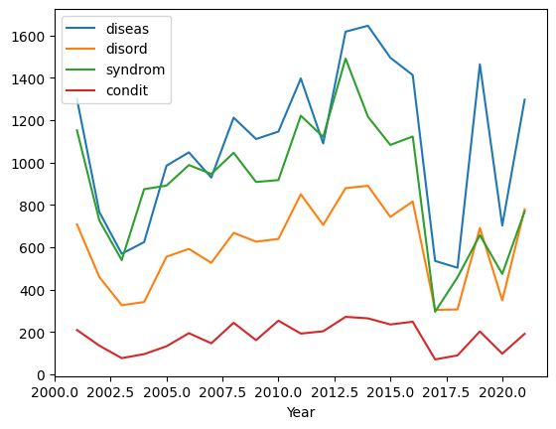
Track target words over time
Notes:
Here, we see the word frequency for a select set of words over time. Anecdotally, it seems like ‘diseas’ should be losing popularity. We know that it is a scary, negative word and many people are trying to use one of these other words instead, but at least in the documents we looked at, there is no real discernible change.

Slide 25
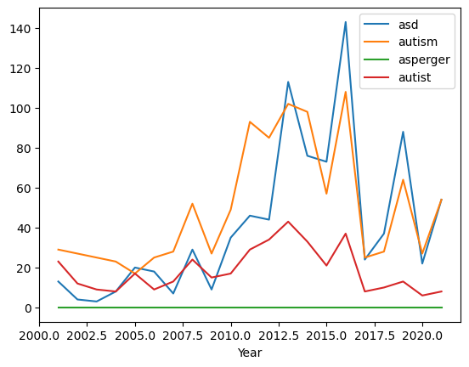
Track target words over time
Notes:
On the other hand, we do see that ASD is gaining popularity, alongside autism, while autistic seems to be losing ground. This suggests that perhaps person-first language is gaining over identity-first language in the context of autism.

Slide 26
NLP pattern extraction to examine context
Prep
Tokenise sentences
* Lowercase
* Remove punctuation
* Remove whitespaces
Consolidate
* Correct spelling
* Substitute synonyms
Isolate relevant sentences
Analyse
Extract person-first and identity-first patterns
Manually check for relevance
Count each pattern
Examine each pattern
POS-tag
* Optional steps that we did not use
Notes:
The second NLP approach I used is to extract relevant patterns. In this case, I tokenise sentences rather than words, isolate only those sentences that have the keywords in, extract only those that match either the person-first or identity-first patterns and check them manually to exclude those that are not about people. Then, I count and examine the context for these.

Slide 27
“Noun with” / person-first pattern
pattern = [{"POS": "NOUN"},
{“LOWER": “with"}
{'DEP':'amod', 'OP':"?"},
{'DEP':'amod', 'OP':"?"},
{'DEP':'amod', 'OP':"?"},
{"TEXT": {"REGEX": “[Au]utism“ or “[Aa]sperger” or “ASD”}}]
Notes:
So, the person first-pattern is a noun, followed by the word “with”, followed by up to three optional modifiers, then the word Autism, or asperberger or ASD.
Relevant examples from this data set include boy with ASD and individual with idiopathic autism. Irrelevant examples that were manually removed included things like “association with autism” or “diagnosis with autism-like behaviour”.

Slide 28
“Adjective noun” / identity-first pattern
pattern = [{"TEXT": {"REGEX": “[Au]utistic“ or “[Aa]sperger” or “ASD”}},
{'DEP':'amod', 'OP':"?"},
{'DEP':'amod', 'OP':"?"},
{'DEP':'amod', 'OP':"?"},
{"POS": "NOUN"}]
Notes:
The Identity-first pattern starts with the word autistic or asperger or ASD followed by up to three optional modifiers and then a noun.
Relevant examples from this dataset include: ASD affected sibling and autistic female while irrelevant examples included “autism diagnosis” or “ASD traits”.

Slide 29
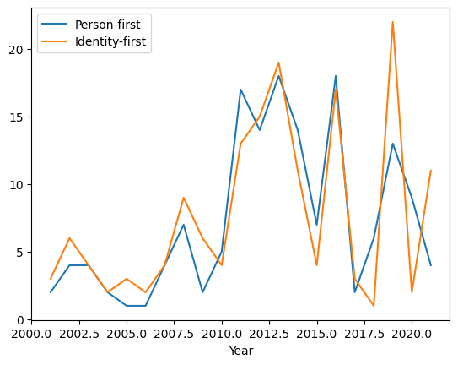
Person-first & Identity-first counts by year
Notes:
So, we see that both patterns are very similar for most of the 20 year history but that they start to diverge after 2018. Perhaps this was a pivotal moment in the person-first/ identity-first discussion? Was there a language guide published for an influential conference? Was there a new editor at a relevant journal? It might be worth more investigation. If we continue to update this graph with new years, we may see these lines continue to diverge or they may come back together. That is a future study.

Slide 30
Most common examples of both patterns
156 total person-first structures, 40 are unique
163 total identity-first structures, 31 are unique
patient with autism | 36.0
patient with ASD | 22.0
child with ASD | 13.0
child with autism | 12.0
individual with autism | 12.0
ASD patient | 31.0
autistic patient | 23.0
autistic child | 14.0
autistic individual | 12.0
ASD case | 11.0
Notes:
Importantly, these counts ignore plurality so there are 36 instances of patient or patients with autism and so on.

Slide 31
169 abstracts >1 patterns, 32 use both
Prevalence of PTEN mutations in Turkish children with autism spectrum disorders and macrocephaly
7 x person-first, 0 x identity-first
Role of serotonin transporter promoter length polymorphism in autism: A south African population based study
0 x person-first, 5 x identity-first
Implicating genetic risk variants for circadian rhythm and sleep trait difficulties in individuals with autism spectrum disorder
5 x person-first, 1 x identity-first
Polymorphism in Serotonin Transporter Gene in Autism
1 x person-first, 5 x identity-first
Notes:
Also very important to note, is that some abstracts use many of one structure and none of the other, but there are also abstracts that use both structures. This is another point which could be for future study, but it would mean diving into the texts to really understand them and that is not NLP so much as just reading.

Slide 32
Future work
Continue as new abstracts become available (2022, 2023, etc.)
Read the abstracts that use both structures or many of one but none of the other
Explore whether the following are factors:
session code as proxy for field/discipline
affiliation country as proxy for native language of author
age of person described
use of keywords in non-people related contexts
other?

Slide 33
A plea to anyone curating text data
Make your data F.A.I.R to improve NLP analysis
Findable – searchable, well-labelled, clear, with good metadata and identifiers
Accessible – subset-able, freely/clearly available
Interoperable – .csv or .json files, potentially multi-table
Re-usable – broken into fields or columns (author, title, year, etc. )

Slide 34
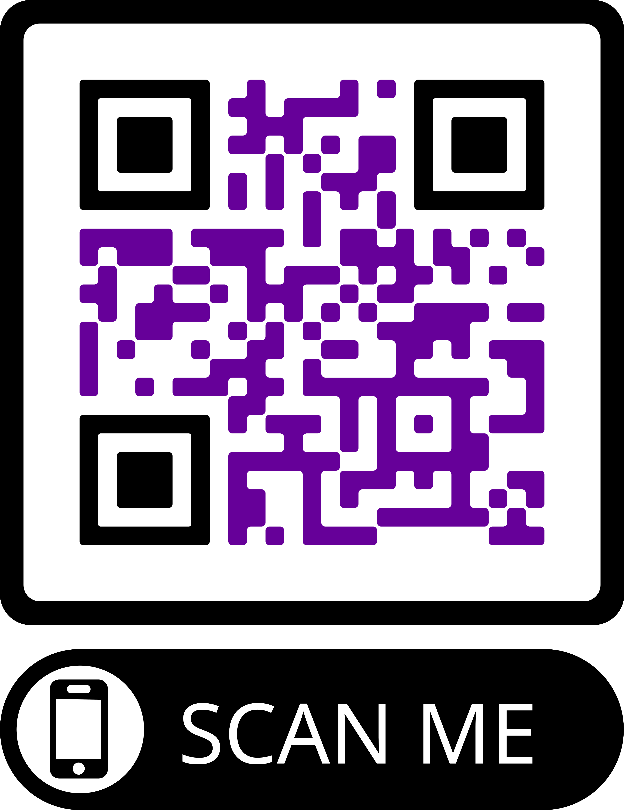
Who we are:
Professor Ramona Moldovan
University of Manchester, UK
Babeș-Bolyai University, Romania
Ramona.Moldovan@manchester.ac.uk
@ramonazmoldovan
Dr. J. Kasmire
Cathie Marsh Institute University of Manchester, UK
UK Data Service
J.Kasmire@manchester.ac.uk
@JKasmireComplex
Dr. Andrada Ciucă
Babeș-Bolyai University, Romania
andradaciuca@psychology.ro
GitHub repo
with our
code and data!
Notes:
Clearly, there is a problem with 2004.

